Slide 1

HUMANITY ROOTS
Here is where the fun begins

Slide 2
The game is based on the root of evolution: fire
It is a survival game in which the character must collect objects to avoid dying of cold and starvation before time runs out
The character moves with the W A S D keys or the arrow keys and releases the objects with the space bar

Slide 3
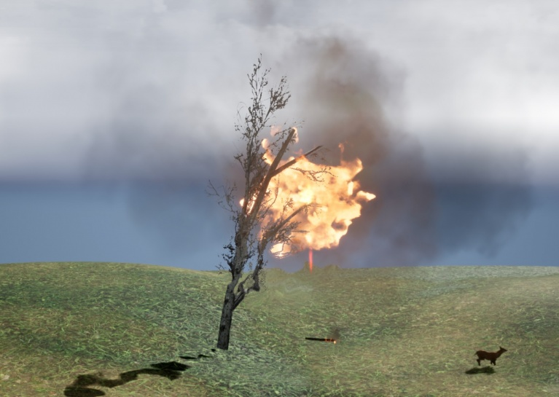
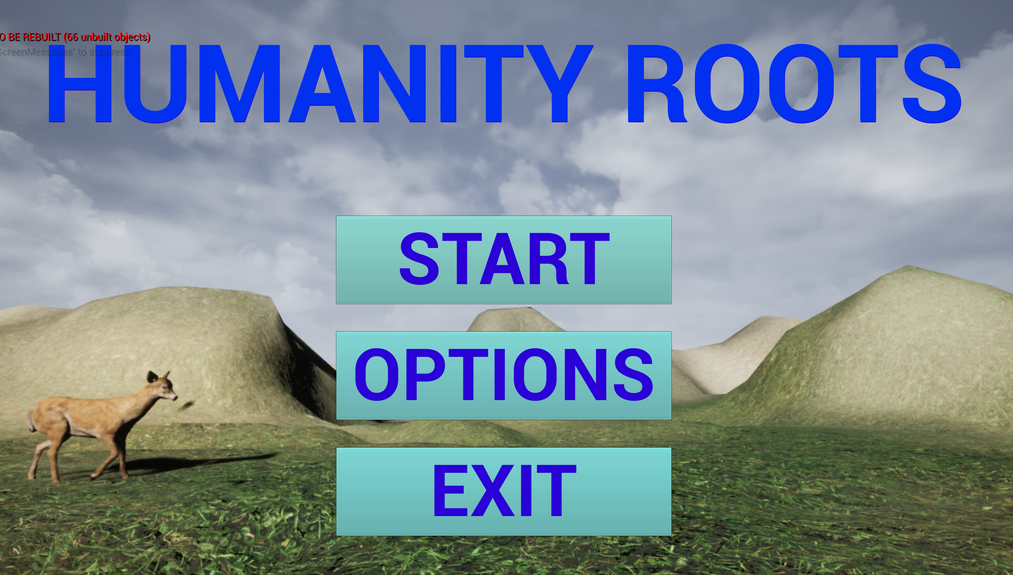
START THE GAME

Slide 4
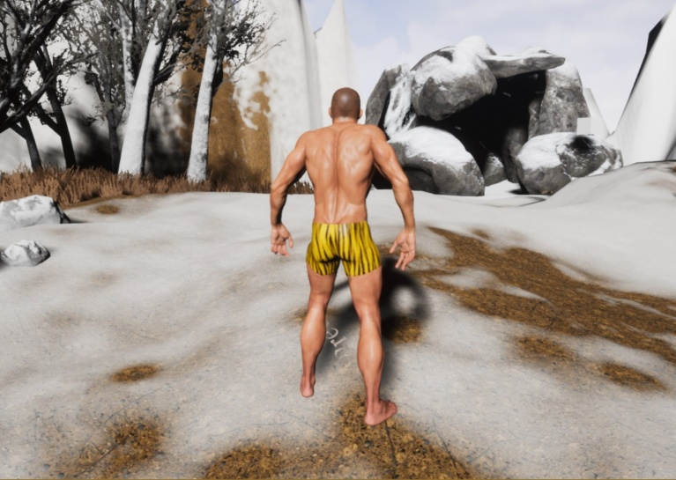
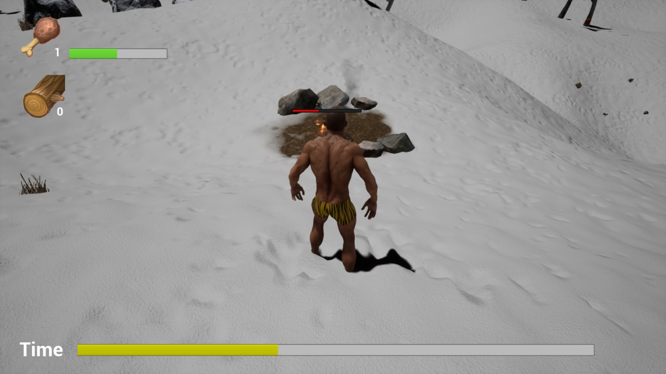
LEVEL 1

Slide 6
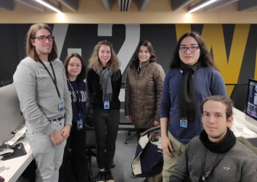
THE TEAM

